Slide 1
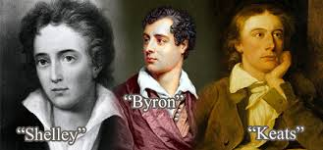
The Second Generation
ELIT214 Romanticism
Dr. Pelin GÖLCÜK MİRZA
Week 12-13

Slide 2
The Second Generation
*Less idealized view of nature
*Interest in Greek culture, mythology, religion and politics
*Complex form of poetry
*Early death:Keats at 25, Shelley at 30, and Lord Byron at 36
*Closet Drama

Slide 3

Closet Drama
«Plays to be read»
Those plays partook of no set pattern or form, but they are more lyrical in natüre.
This allowed the development of an ideal romantic rebel, a hero who would epitomize those ideas of freedom and individualism so dear to the hearts of the romantics.

Slide 4

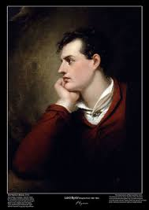
George Gordon Byron
Fascination with the internal dramas of the individual mind
Intensity of feelings
Arch-Romantic
Assisted in the Greek war for independence from the Ottoman Empire

Slide 5

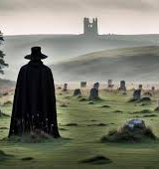
Byron’s view on Nature
Nature is not a source of consolation and joy. It does not embody any theory but the wildest and most exotic natural landscapes reflect the poet’s mood

Slide 6
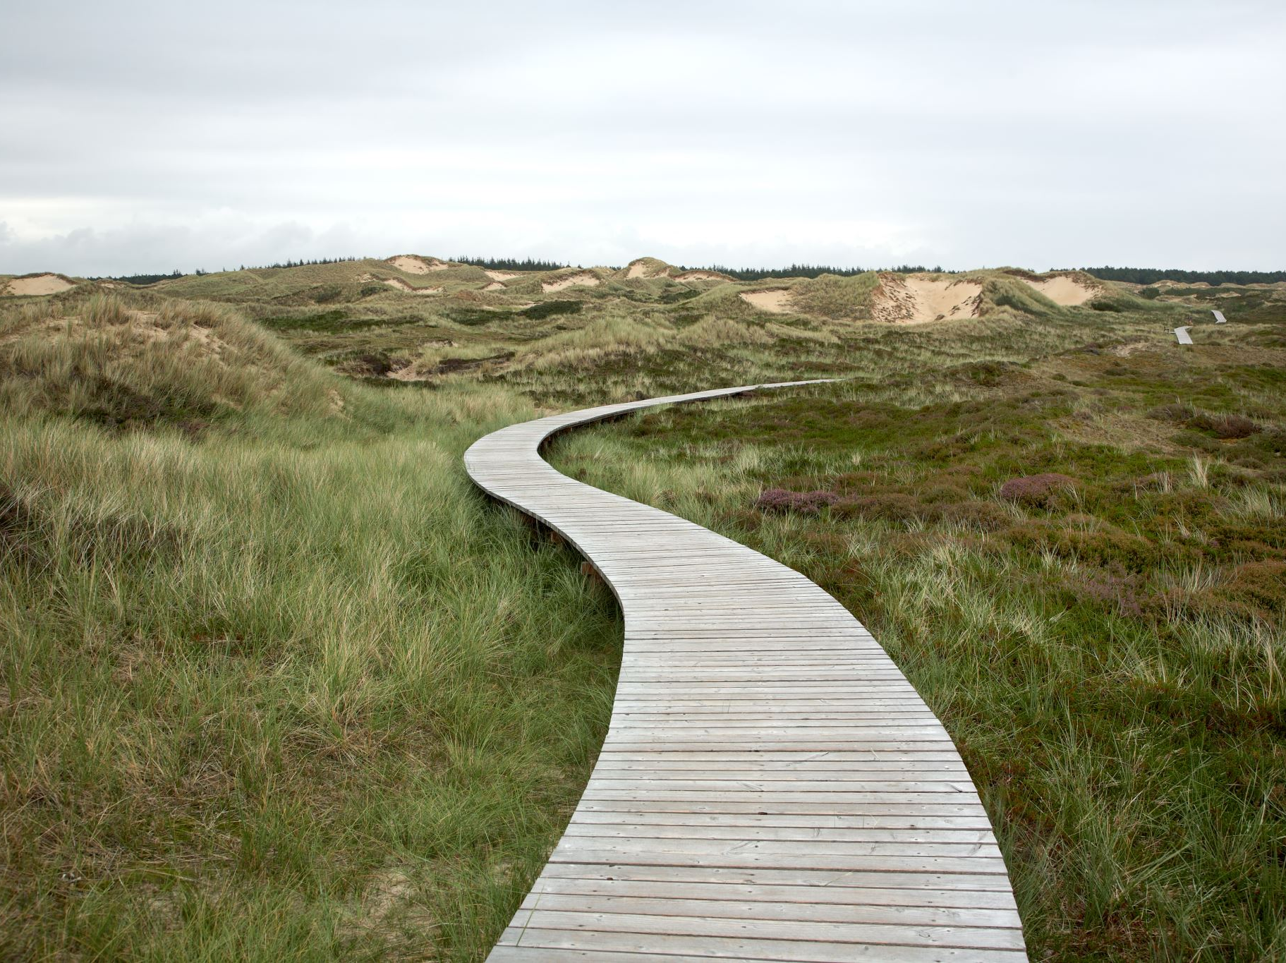
BYRONIC HERO
A moody, restless, mysterious but charming romantic rebel.
He rejects the conventional moral rules of society and bored with the excess of the World.
He is of noble birth.
He hides some sin or secret in his past.
He undergoes violent and romantic adventures.
Characterised by proud individualism.
An outsider, isolated and attractive at the same time.

Slide 7

Main works of Lord Byron
1812–1818
Childe Harold’s Pilgrimage
1813
• The Giaour (1813), The Corsair, and Lara (1814): a series of verse narratives.
1817
• Manfred, a closet tragedy (1817). ( metaphysical drama-drama of ideas)
1819–1824
• Don Juan

Slide 8
MANFRED
And a magic voice and verse
Hath baptized thee with a curse;
And a spirit of the air
Hath begirt thee with a snare;
In the wind there is a voice
Shall forbid thee to rejoice;
And to thee shall Night deny
All the quiet of her sky;
And the day shall have a sun,
Which shall make thee wish it done.
  From thy false tears I did distil
  An essence which hath strength to kill;
  From thy own heart I then did wring
  The black blood in its blackest spring;
  From thy own smile I snatch'd the snake,
  For there it coil'd as in a brake;
  From thy own lip I drew the charm
  Which gave all these their chiefest harm;
  In proving every poison known,
  I found the strongest was thine own.

Slide 9
By thy cold breast and serpent smile,
By thy unfathom'd gulfs of guile,
By that most seeming virtuous eye,
By thy shut soul's hypocrisy; By the perfection of thine art
Which pass'd for human thine own heart; By thy delight in others' pain,
And by thy brotherhood of Cain,
I call upon thee! and compel
Thyself to be thy proper Hell!

Slide 10
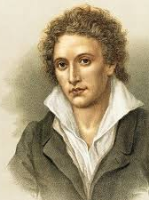
Percy Bysshe Shelley
regarded among the finest lyric poets in the English language.
The novelist Mary Shelley was his second wife.

Slide 11
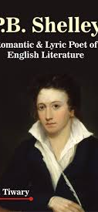
Shelley's unconventional life and uncompromising idealism, combined with his strong disapproving voice, made him an authoritative and much-denigrated figure during his life and afterward.
Shelley never lived to see the extent of his success and influence. Some of his works were published, but they were often suppressed upon publication.
Studied at Oxford University from which he was expelled because of a radical pamphlet, The Necessity of Atheism.

Slide 12
He became an idol of the next three or even four generations of poets, including the important Victorian and Pre-Raphaelite poets.
He was admired by Karl Marx, George Bernard Shaw, Bertrand Russell, Isadora Duncan and Jiddu Krishnamurti ("Shelley is as sacred as the Bible.") Henry David Thoreau's civil disobedience and Mohandas Karamchand Gandhi's passive resistance were influenced and inspired by Shelley's nonviolence in protest and political action.

Slide 13
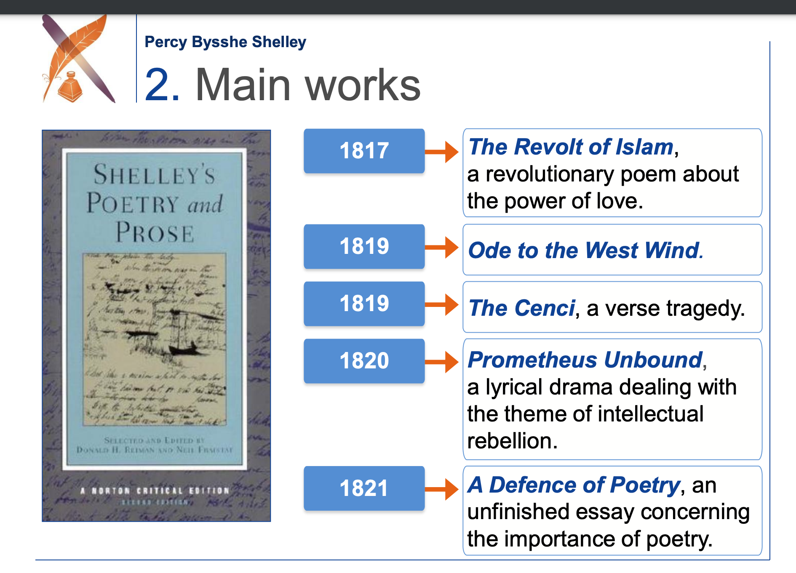

Slide 14
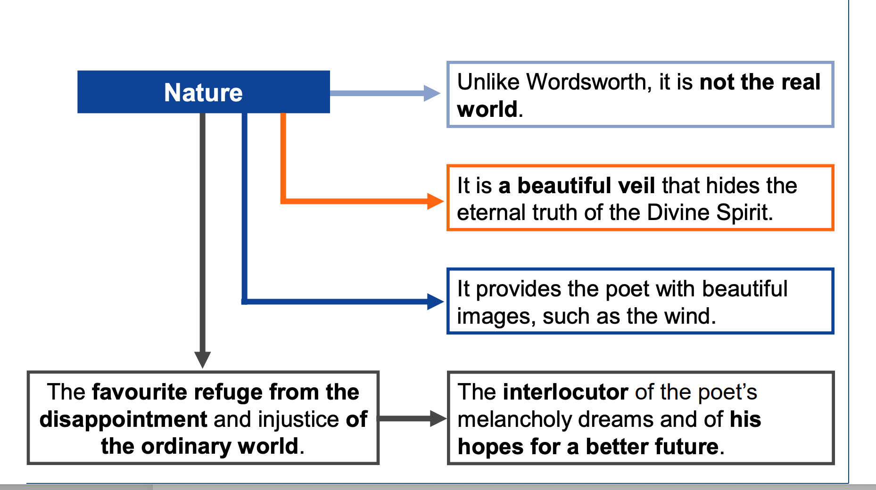

Slide 15
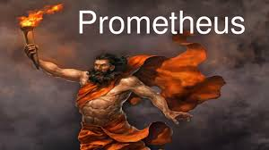
The Poet’s Task
A prophet/ a Titan challanging the cosmos
His task is to help mankind to reach an ideal world where freedom, love and beauty are delivered from tyranny, destruction and alienation.

Slide 16
OZYMANDIAS
I met a traveller from an antique land,
Who said—“Two vast and trunkless legs of stone
Stand in the desert. . . . Near them, on the sand,
Half sunk a shattered visage lies, whose frown,
And wrinkled lip, and sneer of cold command,
Tell that its sculptor well those passions read
Which yet survive, stamped on these lifeless things,
The hand that mocked them, and the heart that fed;
And on the pedestal, these words appear:
My name is Ozymandias, King of Kings;
Look on my Works, ye Mighty, and despair!
Nothing beside remains. Round the decay
Of that colossal Wreck, boundless and bare
The lone and level sands stretch far away.”

Slide 17
ODE TO THE WEST WIND
O wild West Wind, thou breath of Autumn's being,
Thou, from whose unseen presence the leaves dead
Are driven, like ghosts from an enchanter fleeing,
  Yellow, and black, and pale, and hectic red,
  Pestilence-stricken multitudes: O thou,
  Who chariotest to their dark wintry bed
The winged seeds, where they lie cold and low,
Each like a corpse within its grave, until
Thine azure sister of the Spring shall blow
  Her clarion o'er the dreaming earth, and fill
  (Driving sweet buds like flocks to feed in air)
  With living hues and odours plain and hill:
Wild Spirit, which art moving everywhere;
Destroyer and preserver; hear, oh hear!

Slide 18
II
Thou on whose stream, mid the steep sky's commotion,
Loose clouds like earth's decaying leaves are shed,
Shook from the tangled boughs of Heaven and Ocean,
  Angels of rain and lightning: there are spread
  On the blue surface of thine aëry surge,
  Like the bright hair uplifted from the head
Of some fierce Maenad, even from the dim verge
Of the horizon to the zenith's height,
The locks of the approaching storm. Thou dirge
  Of the dying year, to which this closing night
  Will be the dome of a vast sepulchre,
  Vaulted with all thy congregated might
Of vapours, from whose solid atmosphere
Black rain, and fire, and hail will burst: oh hear!

Slide 19
III
Thou who didst waken from his summer dreams
The blue Mediterranean, where he lay,
Lull'd by the coil of his crystalline streams,
Beside a pumice isle in Baiae's bay,
And saw in sleep old palaces and towers
Quivering within the wave's intenser day,
All overgrown with azure moss and flowers
So sweet, the sense faints picturing them! Thou
For whose path the Atlantic's level powers
Cleave themselves into chasms, while far below
The sea-blooms and the oozy woods which wear
The sapless foliage of the ocean, know
Thy voice, and suddenly grow gray with fear,
And tremble and despoil themselves: oh hear!

Slide 20
IV
If I were a dead leaf thou mightest bear;
If I were a swift cloud to fly with thee;
A wave to pant beneath thy power, and share
The impulse of thy strength, only less free
Than thou, O uncontrollable! If even
I were as in my boyhood, and could be
The comrade of thy wanderings over Heaven,
As then, when to outstrip thy skiey speed
Scarce seem'd a vision; I would ne'er have striven
As thus with thee in prayer in my sore need.
Oh, lift me as a wave, a leaf, a cloud!
I fall upon the thorns of life! I bleed!
A heavy weight of hours has chain'd and bow'd
One too like thee: tameless, and swift, and proud.

Slide 21
V
Make me thy lyre, even as the forest is:
What if my leaves are falling like its own!
The tumult of thy mighty harmonies
Will take from both a deep, autumnal tone,
Sweet though in sadness. Be thou, Spirit fierce,
My spirit! Be thou me, impetuous one!
Drive my dead thoughts over the universe
Like wither'd leaves to quicken a new birth!
And, by the incantation of this verse,
Scatter, as from an unextinguish'd hearth
Ashes and sparks, my words among mankind!
Be through my lips to unawaken'd earth
The trumpet of a prophecy! O Wind,
If Winter comes, can Spring be far behind?

Slide 22
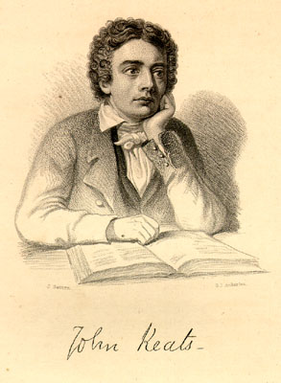

Slide 23
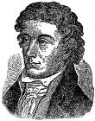
John Keats was born on 31 October 1795, the first of Frances Jennings and Thomas Keats's five children, one of whom died in infancy.
When Keats was nineteen, in 1815, Keats registered as a medical student at Guy’s Hospital.Though he continued his work and training at Guy's, Keats was devoting increasing time to the study of literature.
In May 1816, Leigh Hunt, greatly admired by Keats, agreed to publish the sonnet O Solitude in his magazine The Examiner ,a leading liberal magazine of the day.

Slide 24
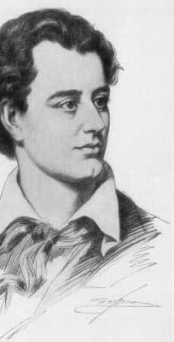
John Keats was the latest born of the great Romantic poets.
Along with Byron and Shelley , he was one of the key figures in the second generation of the movement, despite publishing his work over only a four-year period.during his short life, his work was not well received by critics, but his posthumous influence on poets such as Alfred Tennyson and Wilfred Owen was significant.
The poetry of Keats was characterised by sensual imagery, most notably in the series of odes which remain among the most popular poems in English literature.
The letters of Keats are among the most celebrated by any English poet

Slide 25
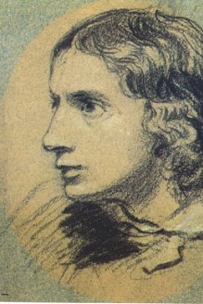
He couldn't develope himself in his early ages and he was an usual poet.
But he suddenly become a great poet in 1819,at the age of 23.
He wrote most beutiful poems in a year.
Keats belived that he should write a long poem to examine himself
In April 1817, shortly after giving Abbey his first book, Keats embarked on a four-month tour
through Carisbrooke, Canterbury, Hastings, etc He also wrote the first books of "Endymion “
which is more than four thousands stanzas in 1818.
Endymion is a long narrative poem in four books of about one thousand lines each, written mostly in heroic couplets.
It is named after its hero, Endymion, a figure taken from Greek myth

Slide 26
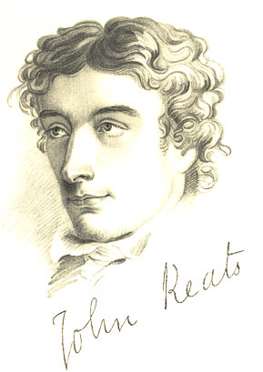
His other poems :
The Eve of St Agnes
Lamia
Isabella
La Bella Dame Sans Merci
Last Sonnet
On First Looking Into Chapman's Homer
When I Have Fears That I May Cease to Be
His sones:
"Sleep and Poetry "
"I stood Tiptoe upon a Little Hill"

Slide 27
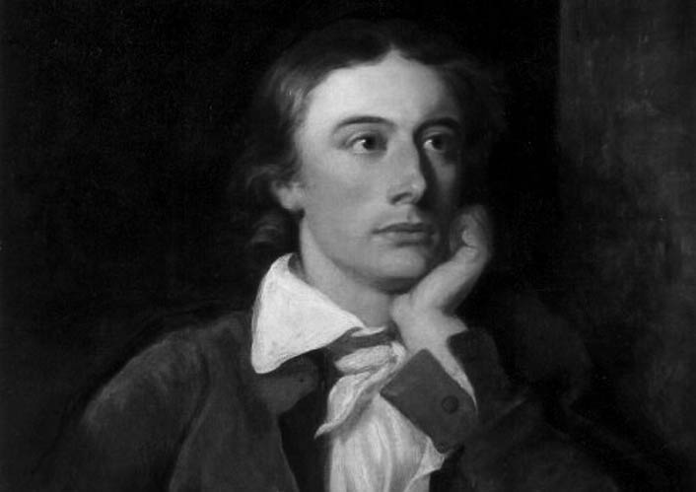
Keats originated by Greek Mythology and wrote "Ode" .This means "song" in Greek.
"Ode on Indolence"
"Ode on Psyche"
"Ode on Autumn"
"Ode to Meloncholy"
"Ode to a Grecian Urn"

Slide 28
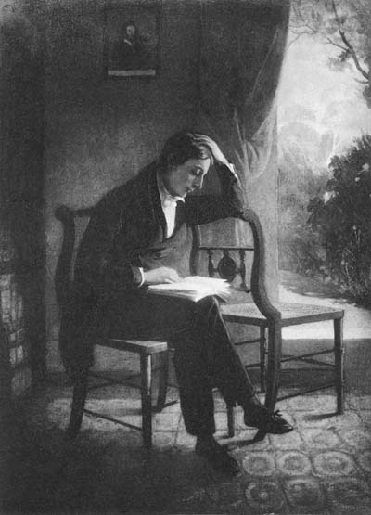
John Keats :
is said " painter-poet"
interested with Middle Ages ,especially Greek
did not like "the didactic poems" and said "We hate poetry that has a palpable design upon us."
wanted to a revolution on theatre literature but he couldn’t do .

Slide 29

Thou still unravish'd bride of quietness,
Thou foster-child of silence and slow time,
Sylvan historian, who canst thus express
A flowery tale more sweetly than our rhyme:
What leaf-fring'd legend haunt about thy shape
Of deities or mortals, or of both,
In Tempe or the dales of Arcady?
What men or gods are these? What maidens loth?
What mad pursuit? What struggle to escape?
What pipes and timbrels? What wild ecstasy?
Heard melodies are sweet, but those unheard
Are sweeter: therefore, ye soft pipes, play on;
Not to the sensual ear, but, more endear'd,

Slide 30
Pipe to the spirit ditties of no tone:
Fair youth, beneath the trees, thou canst not leave
Thy song, nor ever can those trees be bare;
Bold lover, never, never canst thou kiss,
Though winning near the goal - yet, do not grieve;
She cannot fade, though thou hast not thy bliss,
For ever wilt thou love, and she be fair!
Ah, happy, happy boughs! that cannot shed
Your leaves, nor ever bid the spring adieu;
And, happy melodist, unwearied,
For ever piping songs for ever new;
More happy love! more happy, happy love!
For ever warm and still to be enjoy'd,

Slide 31
Though winning near the goal - yet, do not grieve;
She cannot fade, though thou hast not thy bliss,
For ever wilt thou love, and she be fair!
Ah, happy, happy boughs! that cannot shed
Your leaves, nor ever bid the spring adieu;
And, happy melodist, unwearied,
For ever piping songs for ever new;
More happy love! more happy, happy love!
For ever warm and still to be enjoy'd,
For ever panting, and for ever young;
All breathing human passion far above,
That leaves a heart high-sorrowful and cloy'd,
A burning forehead, and a parching tongue.

Slide 32
Who are these coming to the sacrifice?
To what green altar, O mysterious priest,
Lead'st thou that heifer lowing at the skies,
And all her silken flanks with garlands drest?
What little town by river or sea shore,
Or mountain-built with peaceful citadel,
Is emptied of this folk, this pious morn?

Slide 33
was Written in 1819, the third of the five 'great odes' of 1819,
which are generally believed to have been written in the following order - Psyche, Nightingale, Grecian Urn, Melancholy, and Autumn. Of the five, Grecian Urn and Melancholy are merely dated '1819'.
is a relic of ancient Greek civilization, an urn painted with two scenes from Greek life. The first scene depicts musicians and lovers in a setting of rustic beauty
This ode contains the most discussed two lines in all of Keats's poetry - '"Beauty is truth, truth beauty," - that is all/Ye know on earth, and all ye need to know.'
"Ode on a Grecian Ode" is based on a series of paradoxes and opposites:
the discrepancy between the urn with its frozen images and the dynamic life portrayed on the urn,
the human and changeable versus the immortal and permanent,
participation versus observation,
life versus art.

Slide 34
The word "ode" itself is of Greek origin, meaning "sung
is divided into five stanzas of ten lines each, the ode contains a narrator's discourse on a series of designs on a Grecian urn.
The poem focuses on two scenes: one in which a lover eternally pursues a beloved without fulfillment, and another of villagers about to perform a sacrifice.
Critics have focused on other aspects of the poem, including the role of the narrator, the inspirational qualities of real-world objects, and the paradoxical relationship between the poem's world and reality.
has a rhyme scheme beginning with a Shakespearian quatrain (ABAB) and ending with a Miltonic sestet (CDECDE

Slide 35
Keats's odes seek to find a "classical balance" between two extremes, and in the structure of "Ode on a Grecian Urn", these extremes are the symmetrical structure of classical literature and the asymmetry of Romantic poetry . The use of the ABAB structure in the beginning lines of each stanza represents a clear example of structure found in classical literature, and the remaining six lines appear to break free of the traditional poetic styles of Greek and Roman odes.
"Ode on a Grecian Urn", which emphasizes words containing the letters "p", "b", and "v", uses syzygy ,the repetition of a consonantal sound.
The poem incorporates a complex reliance on assonance ,which is found in very few English poems. Within "Ode on a Grecian Urn", an example of this pattern can be found in line 13 ("Not to the sensual ear, but, more endear'd") where the "e" of "sensual" connects with the "e" of "endear'd" and the "ea" of "ear" connects with the "ea" of "endear'd".
A more complex form is found in line 11 ("Heard melodies are sweet, but those unheard") with the "ea" of "Heard" connecting to the "ea" of "unheard", the "o" of "melodies" connecting to the "o" of "those" and the "u" of "but" connecting to the "u" of "unheard".

Slide 36
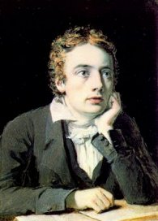
John Keats ideas:
" A think of beauty is a joy for ever."
"I f I should die, said I to myself , I have left no immortal work behind me ...But I have loved the principle of beauty in all things and If I had had time ,
I would have made myself remembered."

Slide 37
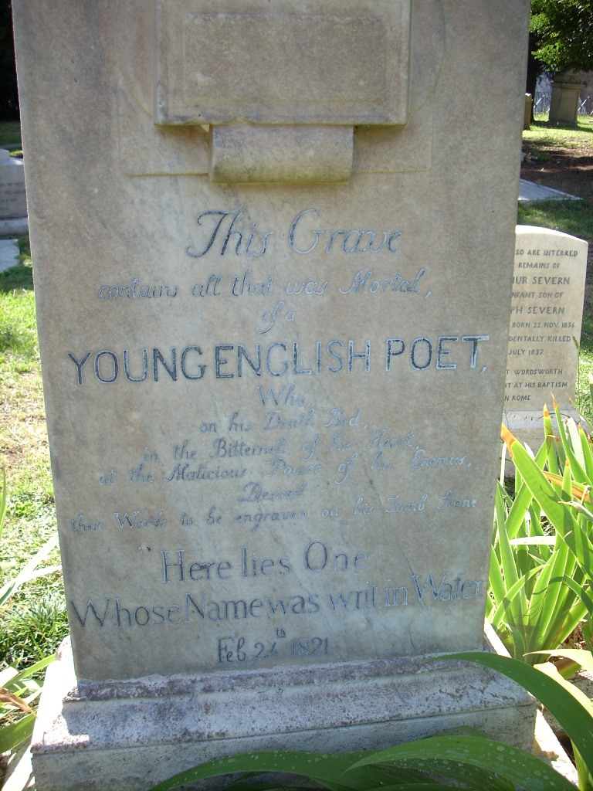
John keats was phthisis and he knew he would die.
When Keats died, at the age of 25 on 23 February 1821 and was buried in the Protestant Cemetery, Rome. His last request was to be buried under a tombstone, without his name, and bearing only the legend:
"Here lies one whose name was writ in water."

Slide 38
He wrote a lot of eternal poems but if he had lived ,he would have been the greatest poet of his generation .

Slide 39


